Slide 1
Dashboard API: Python & Amazon Alexa
Demo Guide

Slide 2
Goals
Showcase the Meraki Dashboard API with Python workflows and an intuitive UX frontend.
Introduce customers to network programmability & automation, opening up new ideas and saving them time & money.
Have fun and strive not to do the same thing repeatedly!

Slide 3
Python Prerequisites

Slide 4
Software Required
(10 minutes) Install Python 3, along with the requests and Meraki modules via pip.
For step-by-step instructions, see Exercise A of the Automation with Python lab.
(1 minute) Also install the geopy module > pip[3] install geopy
(1 minute) Add yourself as a full, org-wide admin on the Demo API Lab org
(15 minutes) Download the meraki_info.py file and edit with your information: API key, org ID, location, name, devices, etc.
(3 minutes) In the same folder, download and save create.py, psk.py, and reset.py.

Slide 5
Amazon Alexa Skill

Slide 6
Getting Started
You will need:
Amazon Echo device or Alexa package running on a device (like a Raspberry Pi), or the Amazon Shopping mobile app on Android/iPhone (pictured right)
Account on developer.amazon.com
Account on aws.amazon.com

Slide 7
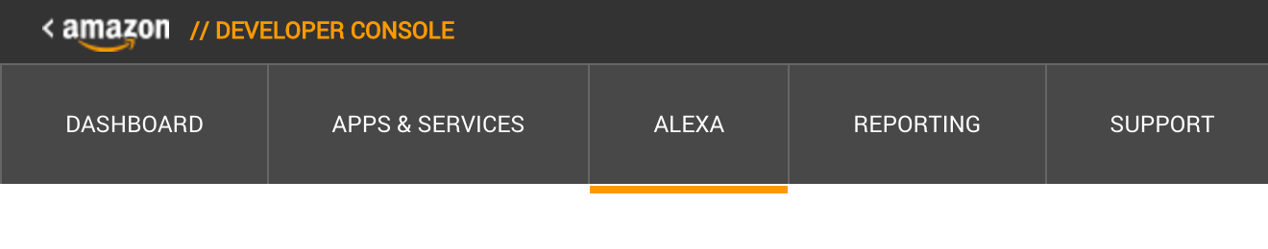
Developer Account
Login to developer.amazon.com, where your custom skill is created and where you define the things you can say to invoke your custom skill. The name of the skill is “Meraki”, so every interaction will start with “Alexa, ask Meraki …”
Click the Alexa section of the menu:

Slide 8
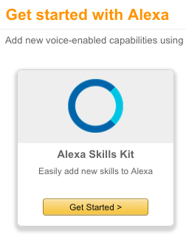
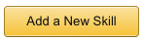
Adding a New Skill
Select Alexa Skills Kit:
Next, add a New Skill:

Slide 9
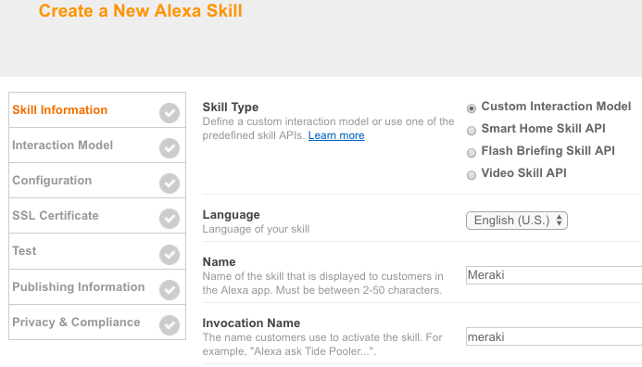
Basic Skill Info
Choose “Custom Interaction Model” and enter the following names:

Slide 10
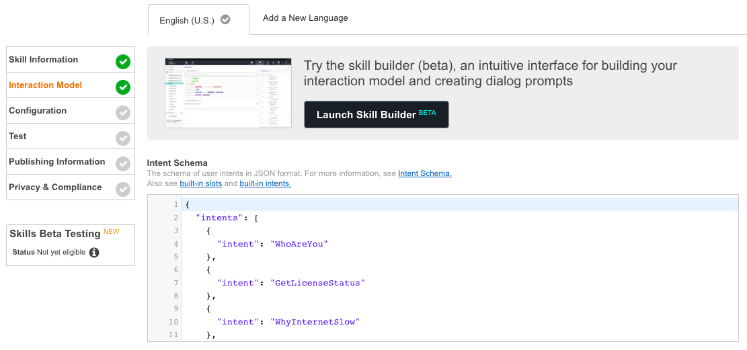
Create Intents (1/2)
Copy contents of Intent Schema into Interaction Model:

Slide 11
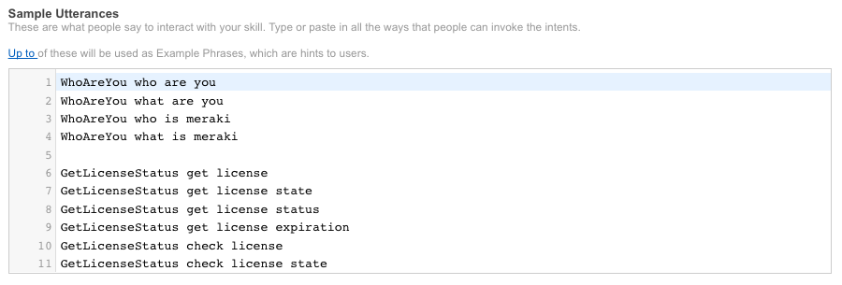
Create Intents (2/2)
In the bottom half of the same Interaction Model page, copy contents
from Sample Utterances. These can be modified to phrases that you choose,
and be sure to modify your name as well for some of the functions to demo!

Slide 12
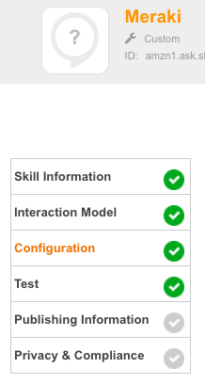
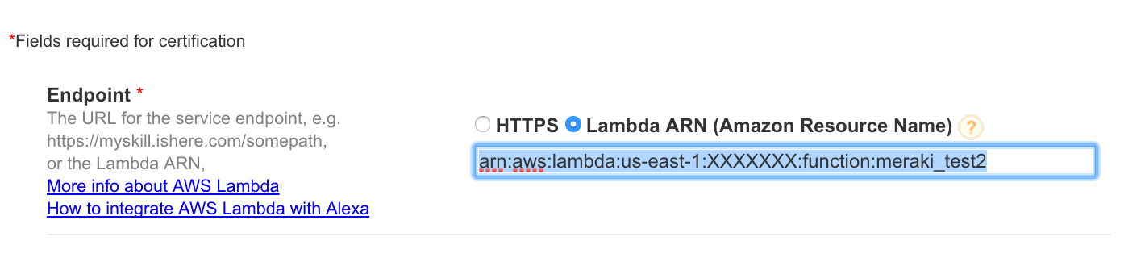
Point to Your Lambda Function
A unique endpoint (ARN: Amazon Resource Name) will be created for your Lambda function (shown in the upper right of the AWS console) which you will enter into the box below (the following slides will cover how to obtain this value, some return here afterwards).

Slide 13
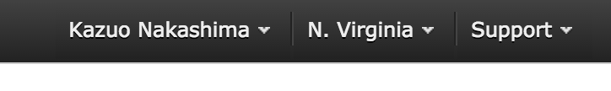
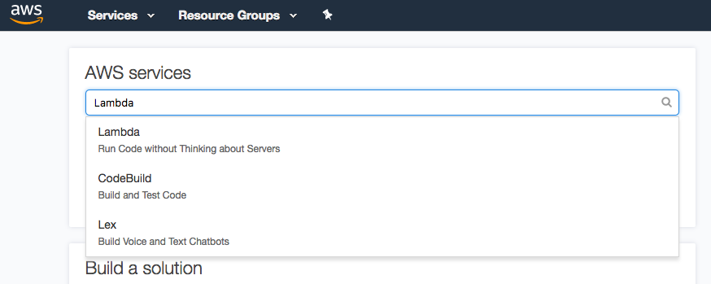
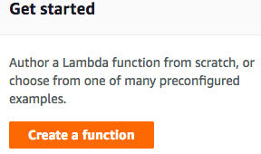
AWS Account
Login to your AWS account, which will be used for access to Lambda where the code associated with your custom skill will run. You may have to setup payment info, but can use the Lambda free tier, which is under 1M requests per month.
Lambda is only available in US East (N. Virginia) currently. Be sure to select that region to see the Lambda option
Search for Lambda and “author from scratch”

Slide 14
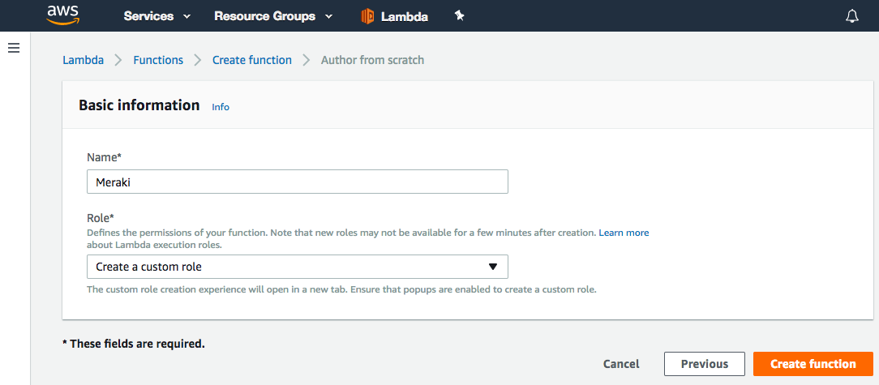
Lambda Function (1/6)
Name the Lambda function, and choose “Create a a custom role”:

Slide 15
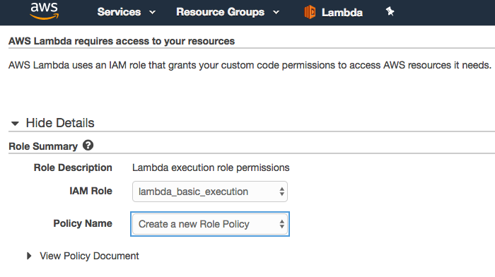
Lambda Function (2/6)
Select the following for role summary, then Allow:

Slide 16
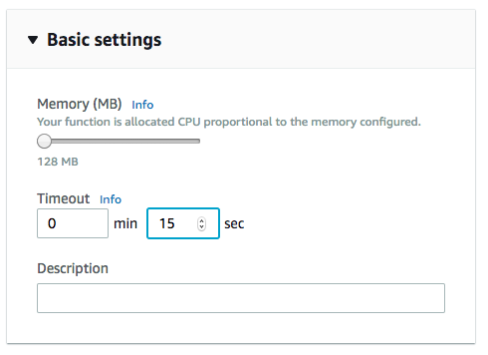
Lambda Function (3/6)
Increase timeout to handle longer scripts & processes (recommended at least 15 seconds as the bare minimum, and can be even longer like 30 or more), and save:

Slide 17
Lambda Function (4/6)
Download, modify, and then re-upload this .ZIP file into the “Function code” section; don’t forget to save!
Logic behind Alexa skill is in lambda_function.py (no need to edit, unless you want to add your own functions later)
Please include and review meraki_info.py, making needed edits
This deployment package created from the “advanced scenario” instructions; if you want to recreate on macOS: 1. add the mentioned setup.cfg file to project directory 2. navigate to that project directory, and then install following modules 3. pip3 install requests -t /path/to/project-dir 4. pip3 install meraki -t /path/to/project-dir [--upgrade]

Slide 18
Lambda Function (5/6)
After you have made the necessary changes to meraki_info.py, zip the entire folder's contents (not the folder itself). For example, similar to this screenshot on macOS:

Slide 19
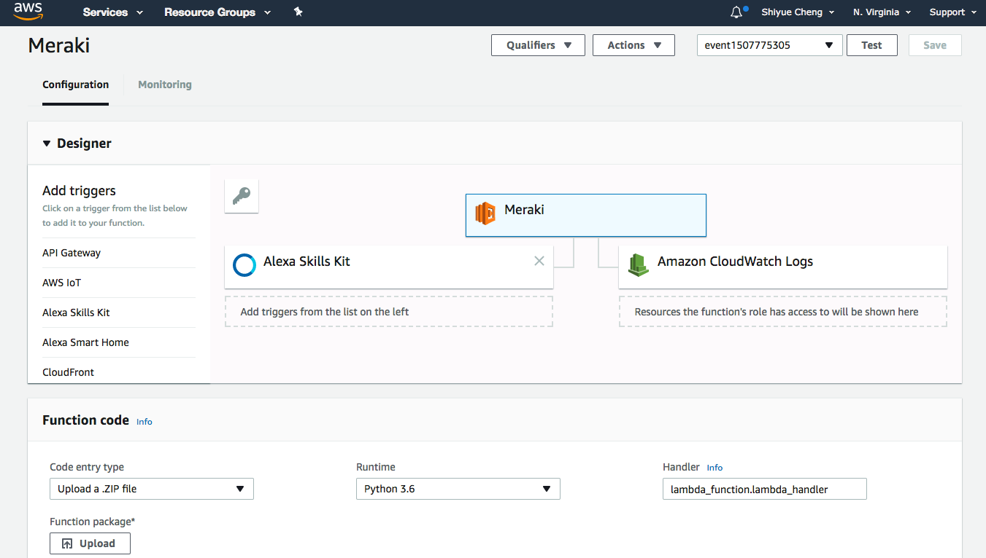
Lambda Function (6/6)
Upload the ZIP file, select “Python 3.6” for runtime, change Handler to “lambda_function.lambda_handler”, and then save:

Slide 20
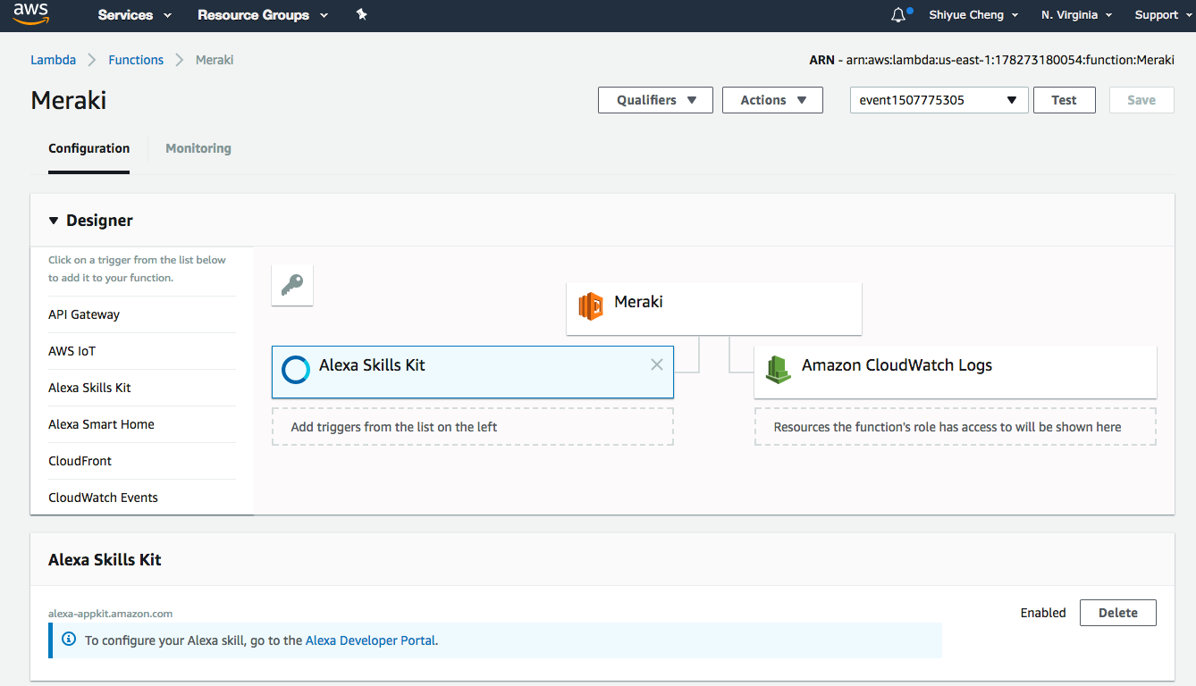
Configure a Trigger
For the Designer section at the top, add the “Alexa Skills Kit” as a trigger:

Slide 21
Finalizing the Lambda Function
Once your function is created and selected, you should see the Amazon Resource Name located in the upper right of the AWS console like the example below:
This is the value you will use for the Lambda ARN back on the “Point to Your Lambda Function” slide

Slide 22
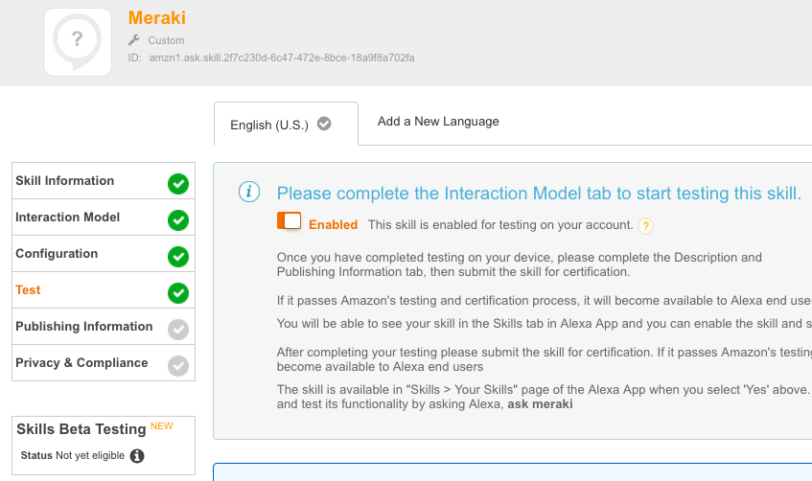
Enable Testing
Enable testing of the skill and enable it on your Echo device via the Alexa app or website. Make sure that the language selected here (“English (U.S.)” in the screenshot, for example) is the same as configured for your Echo on the mobile app or website.

Slide 23
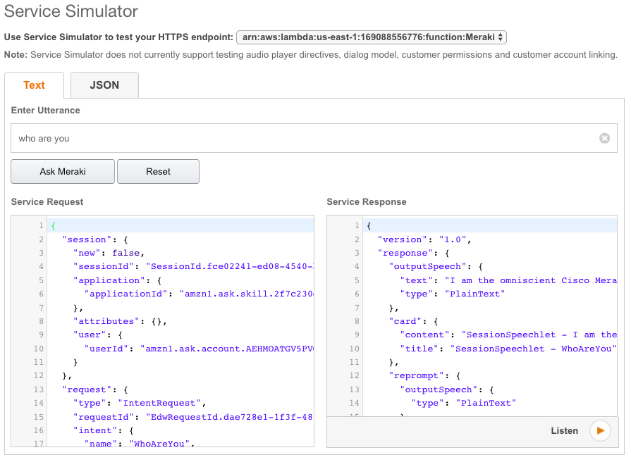
Testing: Text
To run tests without using your actual Alexa-capable device, use the test section to type in “who are you” or “what’s on the roadmap”, and verify the response.

Slide 24
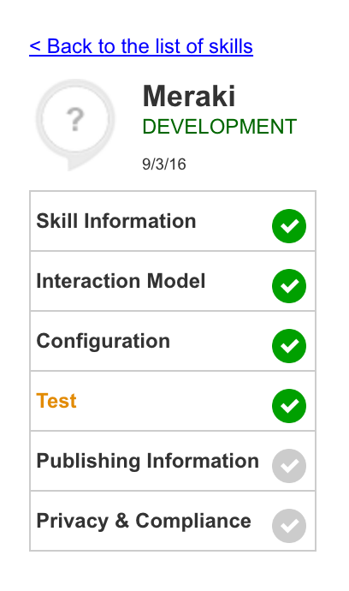
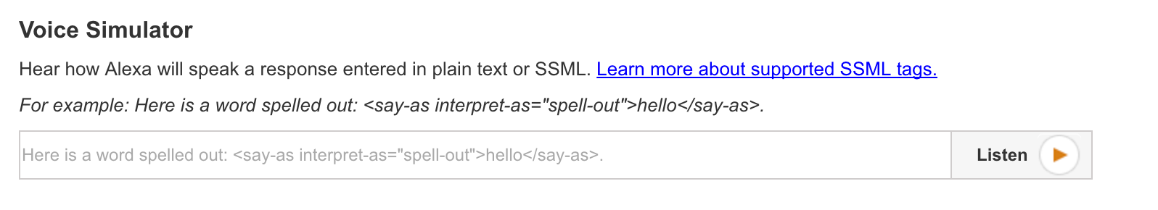
Testing: Speech
The voice simulator tool on the test page is helpful for tuning your speech output. Adding a space, comma, etc. can help Alexa read things back clearly and you can format your speech output based on your preference.

Slide 25
Rock Your Demo!

Slide 26
Python Steps
Show the completely blank Demo API Lab org’s Organization > Overview page
Run the create.py script > python[3] create.py
Refresh Dashboard and show the networks created, along with devices added and mapped.
Run the psk.py script > python[3] psk.py
Browse through several of the networks, showing updated PSKs. Templates and APIs are working hand-in-hand for scalability and automation.

Slide 27
Echo Steps (1/2)
Flip over to your personal kit org for the Amazon Alexa demo. Show network usage and top client: “ASK MERAKI WHY’S THE INTERNET SLOW”
Block the top user’s client devices (generate some traffic beforehand, for example by running YouTube on a client connected behind kit device): “ASK MERAKI TO BLOCK SHAY FROM VIDEO STREAMING” (substitute with your name and group policy, as in the Python prerequisites) On one of these clients, confirm group policy in effect (for example, by trying to access a blocked URL on mobile device with screen sharing).
Try some of the other commands, “ask meraki” for samples:
“ask meraki to get network status”
“ask meraki to check license expiration”
“ask meraki to query device status”
“ask meraki to get client devices”

Slide 28
Echo Steps (2/2)
At the end of the demo, delete all networks created in the initial Demo API Lab org.
“ASK MERAKI TO DELETE ALL MY NETWORKS”
Alternatively, run the reset.py script > python[3] reset.py

Slide 29
Example Demo
Publicly-shareable recording: https://acecloud.webex.com/acecloud/ldr.php?RCID=1e60d5d6bc74b5fe72c631b105d066ef
[Start – 1:04] Getting started with Dashboard API
[1:05 – 2:19] Python script to create networks
[2:20 – 3:59] Python script to update SSIDs/PSKs
[4:00 – 5:21] Alexa call to gather client usage
[5:22 – 8:11] Group policy assignment call
[8:12 – 9:46] Systems Manager endpoint call
[9:47 – End] Delete them networks!
Notes:
https://acecloud.webex.com/acecloud/ldr.php?RCID=0bdc5e4f364f4da0109aeb969006e4f4

